Slide 1

HISTORY OF THE EMERGENCE OF INDEPENDENT BANGLADESH
Dr. Md. Abdul Alim
B. A (Hon’s), M. A (History), M. Phil (Raj), Ph. D (Raj)
Email:doctorabdulalim64@gmail.com
Cell: +880 01718-787466

Slide 2
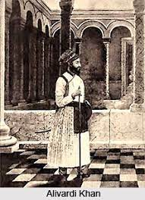
THE RULE OF THE NAWABS (1727-1757 A.D.)
Alivardi Khan (1740-1756 A.D.): Took the power of Bengal not by the authority of the Mughal Emperor, but by sheer power of arms. He established peace in Bengal. From 1742 A.D. to 1751 A.D. he fought for ten years and finally made the Marathi bandits ‘Bargis’ leave the country. As the Afghan army revolted during his reign he suppressed them with an iron had. During the time of Alivardi, many European merchants including the English, carried on commercial activities in different parts of Bengal. At the same time, they went on gathering military power. Alivardi Khan strongly checked their initiatives.

Slide 3
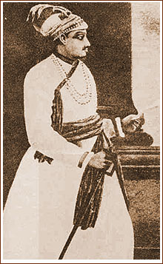
THE RULE OF THE NAWABS (1727-1757 A.D.)
Alivardi Khan chose the son of his youngest daughter Amena Begum, Sirajuddaula as his heir. The first daughter of Alivardi, Ghasheti Begum had the expectation that the son of her second sister Shaokat Jang would be the Nawab. Consequently, she started conspiracy against Sirajuddaula. Ghasheti Begum gained support of some aristocrats. Of them the names of Roydurlav, Mirjafar, Umichand, Rajballav and others can be mentioned. The shrewd English merchants who came to Bengal for trade, exploited this conspiracy inside the palace. They joined hands with conspirators. At last there was a battle between the Nawab and the English. On June 23, 1757 A.D. in the battle of Plassey, the commander-in-chief of the Nawab, Mirjafora unfaithfully desisted from taking part in the battle. Sirajuddaula helplessly suffered defeat. Thus through the battle of Plassey, the foundation of the English rule was laid in Bengal. And with it ended the Middle age in Bengal.

Slide 4
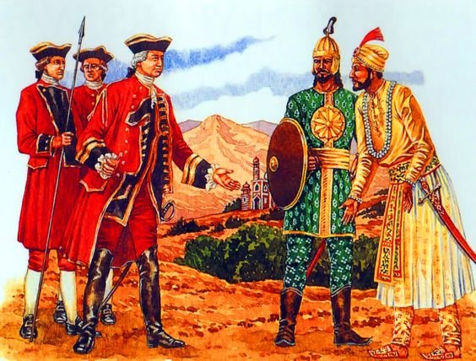
BATTLE OF PLASSEY BACKGROUND
Understanding the circumstances leading up to the Battle of Plassey in 1757 is crucial. Let us look at some of the key events that preceded the Battle of Plassey and became a cause for this battle:
Siraj-Ud-Daula was succeeded by his grandfather Alivardi Khan to become the Nawab of Bengal. He had become the Nawab of Bengal the year before, and he had ordered the English to stop the extension of their fortification.
The victory of the Britishers in the Carnatic wars has made Siraj-Ud-Daula apprehensive about the rising power of the Britishers in India.

Slide 5
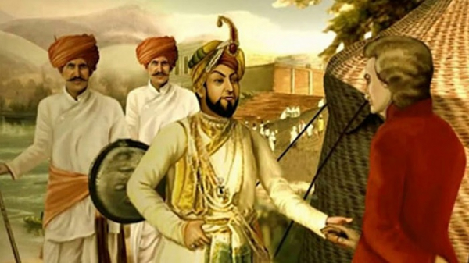
BATTLE OF PLASSEY BACKGROUND
The officials of the Company made rampant misuse of its trade privileges that adversely affected the Nawab’s finances.
The Britishers fortified Fort Williams without the permission of Nawab which infuriated him further. He marched to Fort Williams and captured 146 Britishers and imprisoned them in a small room due to which 123 Britishers died. This incident is known as the “Black Hole Tragedy of Calcutta”.
Upon this, Robert Clive was sent to Bengal to strengthen the position of Britishers in Bengal. He bribed some of the chief members of the Nawab of Bengal and promised kinship to Mir Jafar in return for his betrayal of the Nawab.

Slide 6

BATTLE OF PLASSEY
The Battle of Plassey was fought on 23rd June 1757 in the Palashi region of Bengal.
The 50,000 soldiers in the army of Nawab of Bengal with French troops on their side
severely outnumbered the British army which had around 3000 soldiers.
However, the conspiracy of Robert Clive and the subsequent betrayal by Mir Jafar,
Rai Durlabh and others became the reason for the defeat of Nawab of Bengal Siraj-Ud-Doula in the Battle of Plassey.

Slide 7
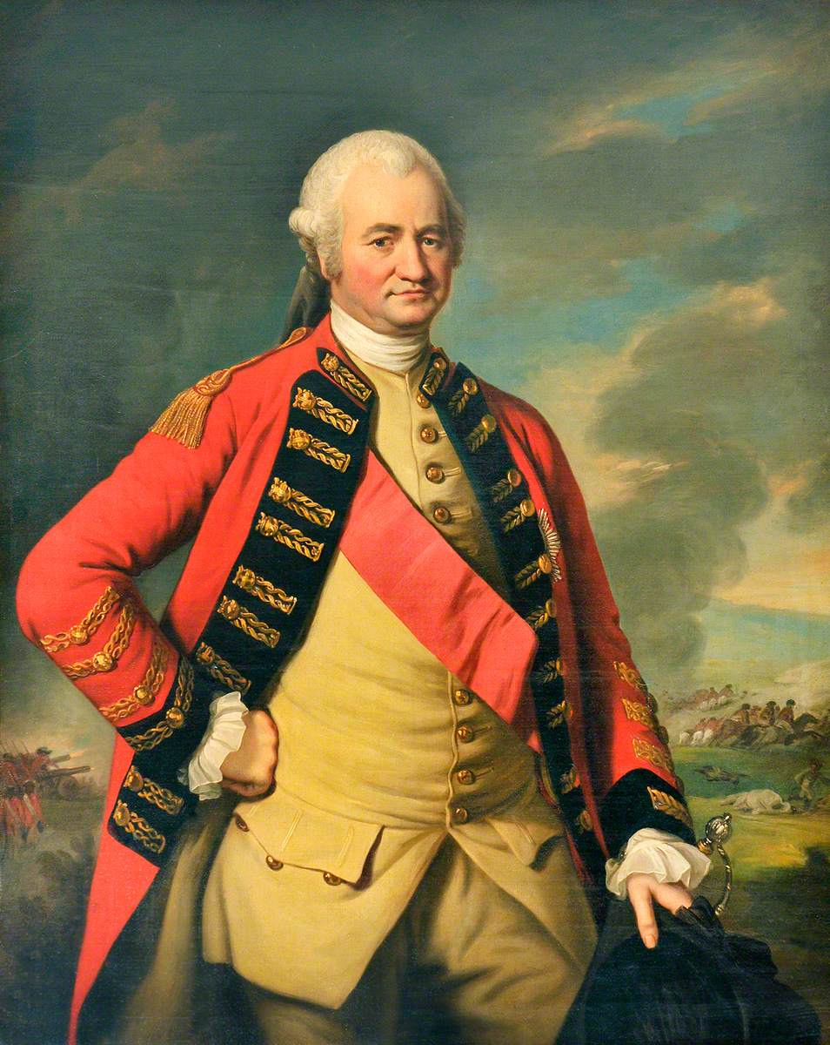
WHO FOUGHT IN BATTLE OF PLASSEY
1. Siraj-ud-Daulah
The Nawab of Bengal was named Siraj-ud-Daulah. It is said that Siraj-ud-Daulah imprisoned 146 English people who were confined to a very small room, causing 123 of them to suffocate to death. While Calcutta was governed by the British, Siraj-ud-Daulah invaded and captured the English fort there.
2. Robert Clive
The East India Company’s top commander in Bengal was Robert Clive. Robert Clive granted sanctuary to Krishna Das, the economic fugitive son of Raj Vallabh, disappointing the Siraj-ud-Daulah. He abused the East India Company’s right to commerce. He strengthened the fort at Calcutta without the Nawab’s consent.
3. Mir Jafar
He was an excellent military leader for the Nawabs. He was bought by the East India Company to defraud Siraj-ud-Daulah. He planned with the East India Company to succeed as Bengal’s Nawab.

Slide 8
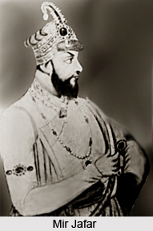
WHO FOUGHT IN BATTLE OF PLASSEY
4. Rai Durlabh
He served as a representative in the Nawab’s courts. Although he joined Siraj-ud-army, Daulah’s he did not participate in battle, betraying Siraj-ud-Daulah.
5. Jagat Seth
He worked in finance. Siraj-ud-Daulah was imprisoned and then killed as a result of his participation in the conspiracy.
6. Urmi Chand
He was a commanding officer over Calcutta. He was in charge of signing the agreement that Clive and others negotiated before the Battle of Plassey.
The key people who betrayed Siraj-Ud-Daula during the Battle of Plassey were Mir Zafar, Rai Durlabh, Khandim Khan. In addition to them, the people who conspired against Siraj that ultimately led to his imprisonment and death were Manikchand, Aminchand and Jagat Seth.
The two people who remained loyal to Siraj-Ud-Daula were Mir Madan and Mohanlal.

Slide 9
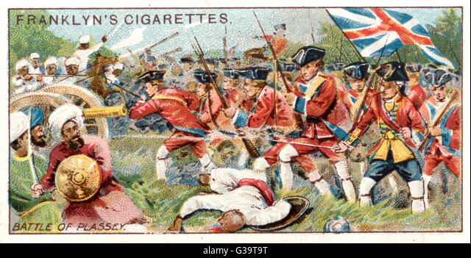
BATTLE OF PLASSEY RESULT
The British Company’s colonialization of India began with the Battle of Plassey. By installing puppet Nawab Mir Jafar on the throne of Bengal, the British Company indirectly consolidated its political authority over Bengal. Bengal was used as a springboard by the British Company to carry out his imperial ambitions.
The theft of riches began with theft, followed by the abuse of privileges, etc. The British Company received the Diwani right 25 (twenty-five) paragana from Mir Jafar. And now the British Company would benefit from the revenue from this area. Lord Clive and other British officers received enormous financial rewards from Mir Jafar in addition to him.

Slide 10
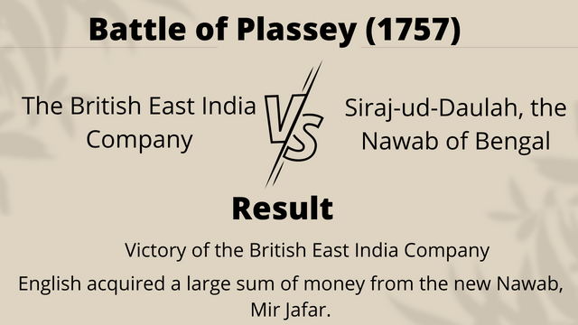
BATTLE OF PLASSEY RESULT
Following the Battle of Plassey, Bengali trade and commerce were exclusively controlled by the British corporation. As a result, Bengal, once a prosperous province of the Mughal Empire, began to become a place of Hunger, Famine, and Deprivation.
The British Company understood after the Battle of Plassey that the Indian people could assist them in conquering India because they had no idea of nationalism and that this revealed the moral weakness of the Indian people.

Slide 11
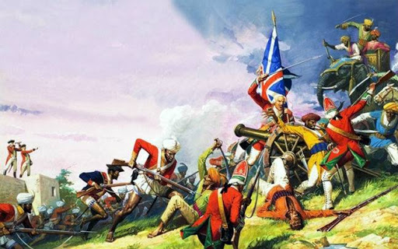
BATTLE OF PLASSEY SIGNIFICANCE
The Transfer of Power was a result of the Battle of Plassey, which is why it is significant. Mir Jafar rose to the position of Nawab of Bengal after the Battle of Plassey. Mir Jafar was a puppet of Nawab, the firm employed him merely to meet its financial requirements. Therefore, that business could swiftly push its colonial interests. The corporation was Imperial, thus Mir Jafar was unable to satisfy its rapacious demands.

Slide 12
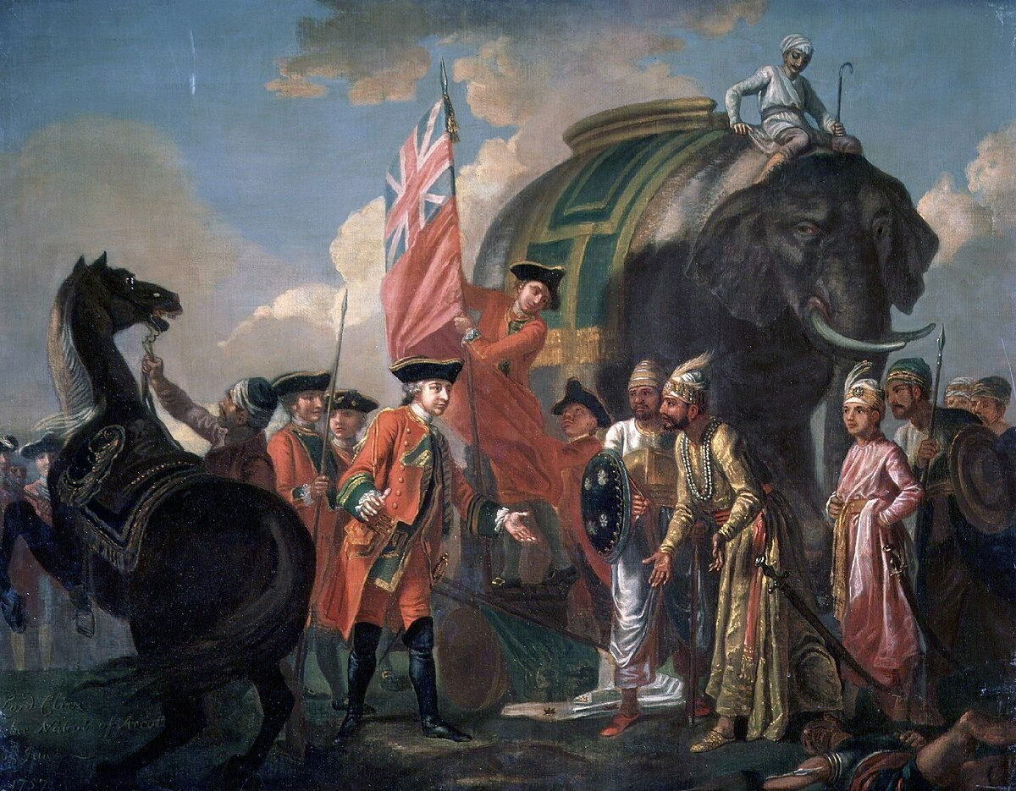
BATTLE OF PLASSEY SIGNIFICANCE
Mir Jafar thus began to become less important in the company’s imperial game. To discredit him, it was said that he had conspired with the Dutch, but the truth was that he had failed to pay the vast sum of money the corporation had requested.
A deal was reached between the British firm and Mir Kasim as a result, and in September 1760, control was transferred. Some historians viewed this change in power in Bengal as a precursor to a revolution.

Slide 13
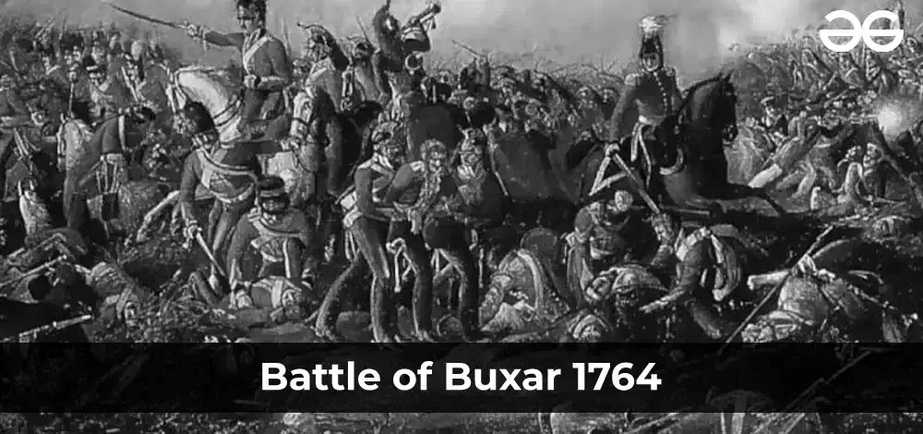
BATTLE OF BUXAR
The Battle of Buxar was one of the pivotal conflicts in India’s history and its lengthy alliance with British Colonial forces. British hegemony over the local kingdoms in the Indian subcontinent was successfully established during the Battle of Buxar 1764 War.
On October 22, 1764, the Battle of Buxar took place at Buxar, Bihar as it is known today. The combined armies of Bengal’s Nawab Mir Qasim, Awadh’s Nawab Shuja-ud-Daula, and Mughal Emperor Shah Alam II fought the East India Company in the Buxar War. To put a stop to the conflict, the Treaty of Allahabad was signed in 1765.

Slide 14
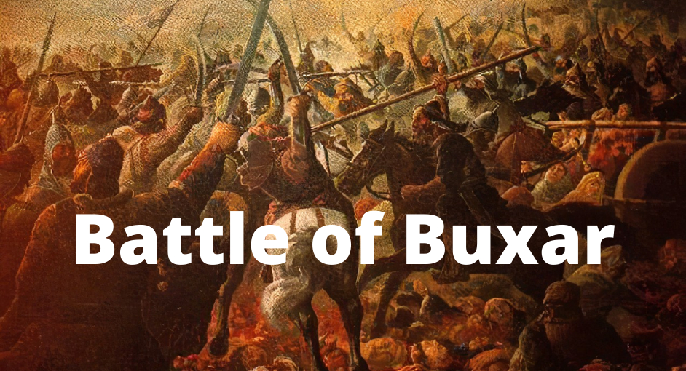
BATTLE OF BUXAR
The Mughal emperor’s combined armies, the Nawabs of Bengal and Oudh, and the English forces engaged in combat at the Battle of Buxar. If one were to look back at the causes of the fight, one would find some historical context. The British took advantage of the commercial privileges that were granted to them, mostly due to their imperial and colonial ambitions toward the territorial, economic, and political conquest of India.

Slide 15
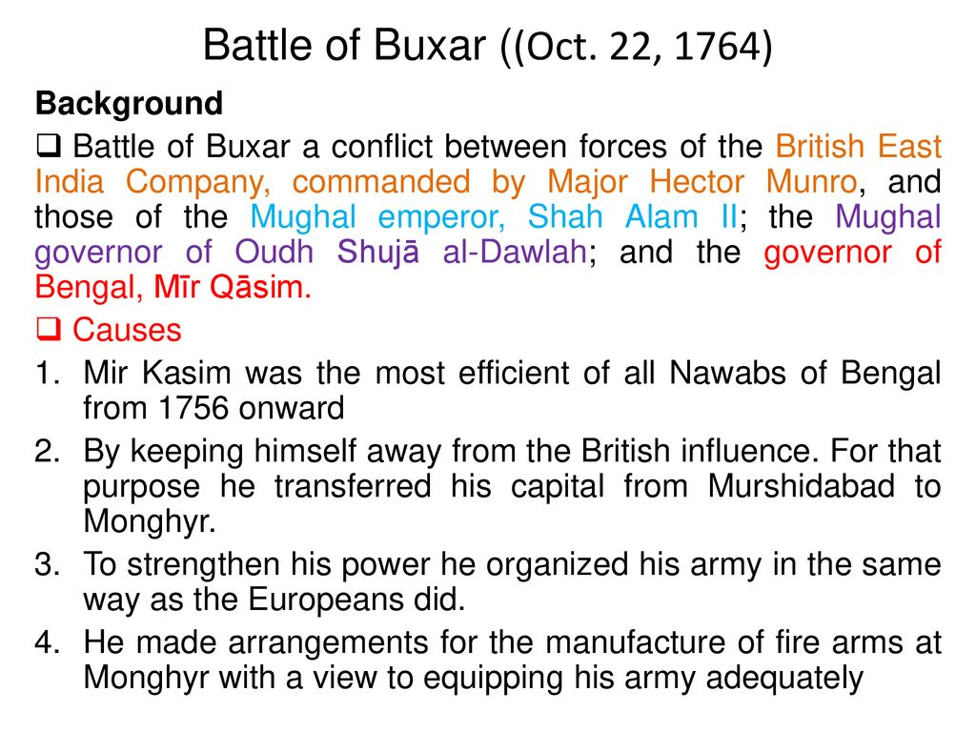
BATTLE OF BUXAR BACKGROUND
1. Mughal Period
Bengal has been a province with significant weight and importance ever since the Mughal era. The province was among the most fertile. And it was affluent. Bihar, Orissa, and the modern-day nation of Bangladesh were all part of Mughal Bengal. The Bengali Nawab held all of the reins of power.
2. Economic Importance
The silk, saltpeter, and world-class textiles produced in Bengal’s province were of enormous economic importance and significance. Saltpetre, indigo, rice, silk, cotton, handicrafts, and other goods are regularly shipped from Bengal to Europe. Almost 60% of British imports from Asia were made up of Bengali products.
reliance on direct control over the provinces blinded them to the emergence of indirect but supreme authority in their hands.

Slide 16
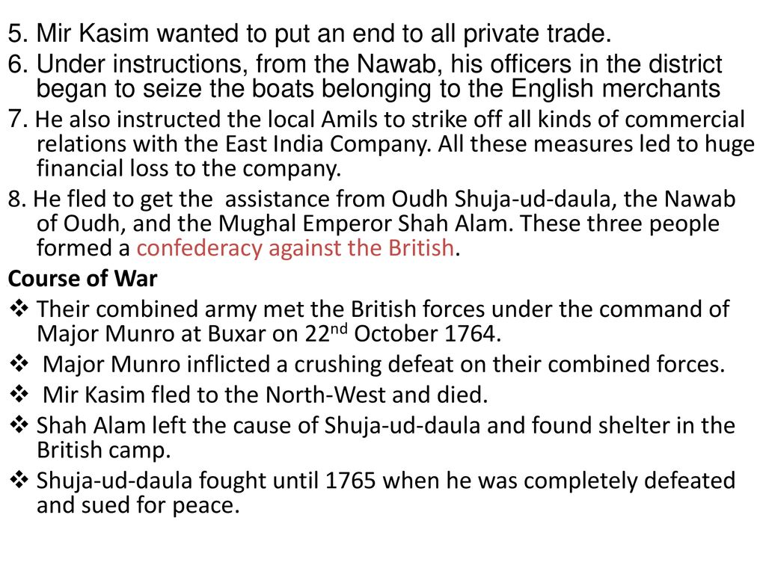
BATTLE OF BUXAR BACKGROUND
3. British Period
Bengal served as the British colonial powers’ stepping stone. It was the first kingdom that British forces had taken control over. Here, the East India Company set up a successful trading system. The British were able to dominate India thanks to Bengal’s vast riches and resources. The British East India Company built Calcutta’s modern-day British commercial settlement’s basis during the 1690s. The Mughal Emperor received an annual payment of Rs 3,000 (about £ 350) from the EIC in exchange for allowing their operations in Bengal.
4. Conflicts between Nawabs and the British
Under the Mughal Empire, the British enjoyed unique privileges, which the Nawabs of Bengal disliked since it diminished their provincial rights. Commercial considerations were the driving force behind the conflict between the Nawabs and the British. The British saw that the Nawabs’ continued

Slide 17
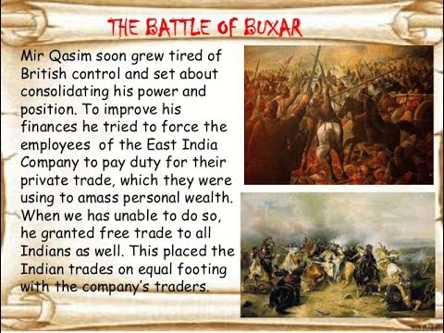
BATTLE OF BUXAR CAUSES
The Battle of Plassey, which enabled the British to establish them in the Bengal region, was followed by the Battle of Buxar. The Nawab of Bengal and his French allies engaged the British army in the Battle of Plassey in June 1757. As a result of this conflict, Siraj-Ud-Daulah was removed from his position as Bengal’s Nawab. Mir Jafar took his place.
Mir Jafar was chosen to serve as the EIC’s puppet. But his son-in-law Mir Qasim took his place when he joined the Dutch East India Company. When Mir Jafar left his position in favor of Qasim, a pension of Rs 1,500 was approved.
When Mir Qasim moved his capital from Calcutta to Munger Fort, he was motivated by self-serving objectives. He began assembling an army by bringing in foreign instructors, some of whom were at war with the British. The English traders received no preferential treatment. He saw both British and Indian traders as sharing the same space.

Slide 18
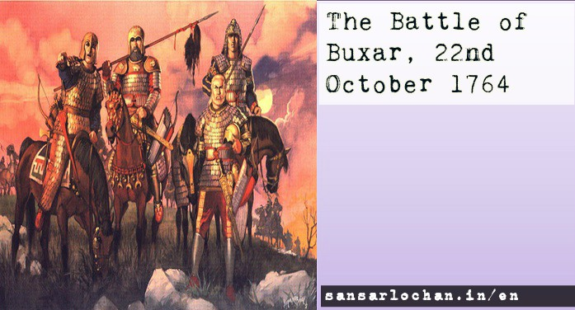
BATTLE OF BUXAR CAUSES
He was not the puppet that the English had expected when they appointed him; therefore they decided to remove him. He made it challenging for the British to exercise indirect authority and gain from a region like Bengal. In 1763, there was a conflict between Qasim and the British.
Being a sovereign independent from British influence and indirect control allowed Qasim to streamline his government. The British EIC’s mistreatment and abuse of Dastak and Farman did not sit well with him. He also made efforts to cut back on spending on administrative and palace operations, which rankled the British.

Slide 19
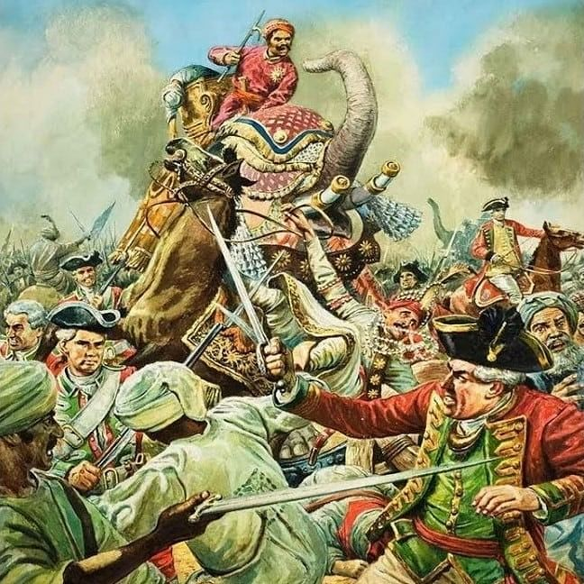
BATTLE OF BUXAR CAUSES
Shuja-ud-Daulah, the Nawab of Oudh, and Shah Alam II of the Mughal Empire were not pleased with the EIC’s expansion into the province of Bengal and their consequent abuse of trade freedoms, which was harming their business. As a result, their soldiers joined forces with Qasim for their mutual interests and gain.
The British sought special treatment that would elevate their industry above that of rivals. Mir Qasim, who treated the British merchants like the Indian merchants, did not offer this. This led to the British beginning to suffer significant losses. This necessitated the conquest of Bengal

Slide 20
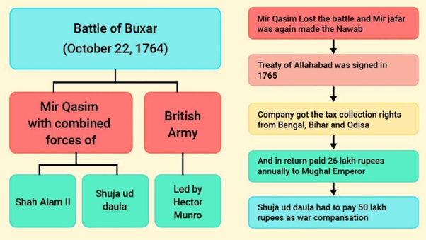
BATTLE OF BUXAR COURSE OF WAR
1. Year 1763
British East India Company and Mir Qasim’s men engaged in combat. While the English won in Katwah, Murshidabad, Giria, Sooty, and Munger, Mir Qasim suffered severely. As a result, Mir Qasim had to leave Awadh (or Oudh). He established a confederacy with Shah Alam II and Shuja-Ud-Daulah (the Nawab of Awadh) to retake Bengal (Mughal Emperor).
2. Year 1764
In 1764, the Mughals, the Nawab of Awadh, and Mir Qasim fought alongside the British Forces. Major Munro oversaw the British side while Mir Qasim headed the Indian side. The 40,000-man Mughal, Awadh, and Mir Qasim united force was ruthlessly crushed by the 10,000-man British Army. The fight was lost by the Indian side on October 22, 1764. The other two submitted to the English forces while Mir Qasim fled the conflict.
3. 1765
In 1765, the British compelled the Nawab of Oudh and the Mughal Emperor to sign the humiliating Treaty of Allahabad.

Slide 21
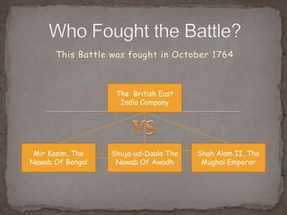
BATTLE OF BUXAR WAS FOUGHT BETWEEN
The Buxar Battle participants and their role in the conflict are described in the table below:
Participants | Role
Mir Qasim | He disliked how the English were misusing data and farmland, which led him to plot against them. Formed a coalition for the Buxar War with the Nawab of Awadh and the Mughal Emperor Shah Alam II.
Shuja-Ud-Daulah (Nawab of Awadh/Oudh) | He was a member of a confederacy with Shah Alam-II and Mir Qasim.
Shah Alam II (Mughal Emperor) | He desired to expel the English from Bengal.
Hector Munro | He was in charge of the English army during the Battle of Buxar
Robert Clive | After triumphing in the Battle of Buxar, he signed the treaties with Shuja-Ud-Daulah and Shah Alam II

Slide 22
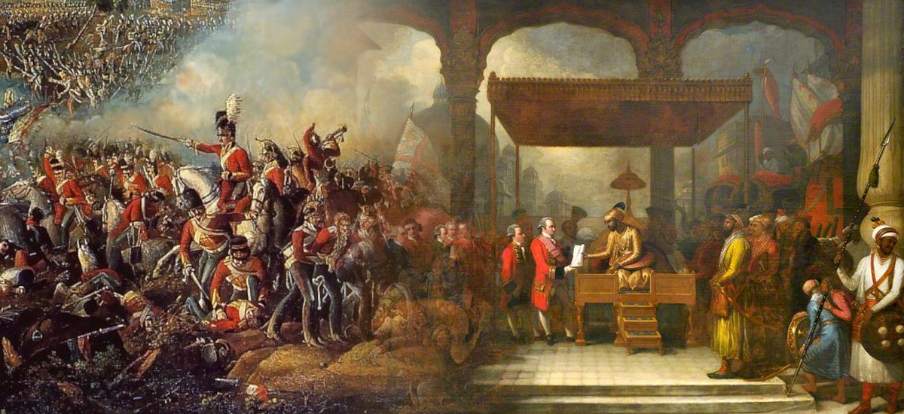
BATTLE OF BUXAR SIGNIFICANCE
Through the Battle of Buxar, colonial dominance over the province of Bengal was formally established. The Nawab had been vanquished and replaced by the EIC’s army. The British now controlled the entire province, which included the modern states of Bihar and Orissa as well as Bangladesh. Even though Mir Qasim fled with vast wealth, Munro’s forces beat the confederacy’s soldiers, and the fugitive Mir Qasim perished in obscurity and poverty.
The Nawab of Bengal’s independence had been put to an end by the Battle of Plassey in 1757. However, the British forces also exerted political dominance and control over the Awadh and the Mughal Empire during the Battle of Buxar. The British gained a solid foundation in India thanks to the Battle of Buxar, which eventually allowed them to dominate the entire country.

Slide 23
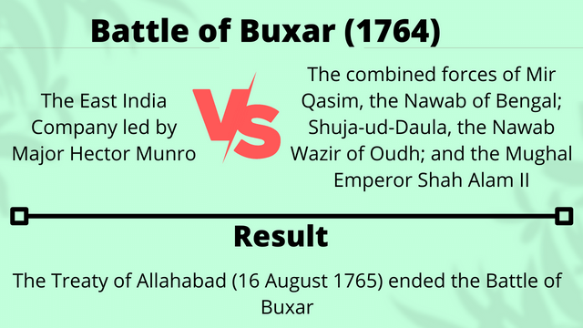
BATTLE OF BUXAR IMPACT
On October 22, 1764, the British forces routed the alliance that Shah Alam II, Shuja-Ud-Daula, and Mir Qasim had formed. Robert Clive played a significant role in the victory that Major Hector Munro oversaw for the British troops. With control over the Mughal domain and the province of Awadh following the Buxar conflict, the English rose to prominence in the North.
Mir Qasim gave the English control over the Midnapore, Burdwan, and Chittagong districts to support the army. Duty-free trade permits were issued to English traders following the Battle of Buxar in 1764. Only salt was still subject to a 2% tariff.

Slide 24
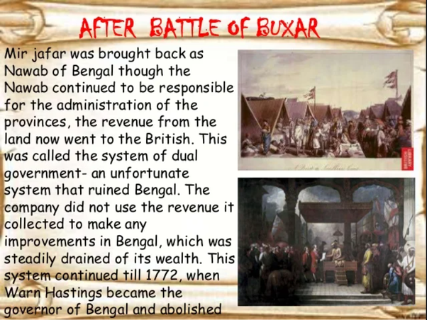
BATTLE OF BUXAR IMPACT
Najimud-Daula, Mir Jafar’s younger son, assumed the throne after his death. However since the English held control over both the military and the government, this was only an acknowledgment of the situation. Shuja-Ud-Daula of Awadh and Shah Alam II had their differences resolved by the Treaty of Allahabad. This was led by Robert Clive.
On October 22, 1764, the British army under Hector Munro engaged an alliance of Indian kings from Bengal, Awadh, and the Mughal Empire at the Battle of Buxar. This pivotal conflict paved the way for the British to dominate India for the following 183 years. After winning the Battle of Plassey in 1757, the British East India Company turned its attention to Bengal. The Mughal Emperor submitted and Bengal was taken over by the British in 1765, marking the end of the conflict...

Slide 25


